Slide 1
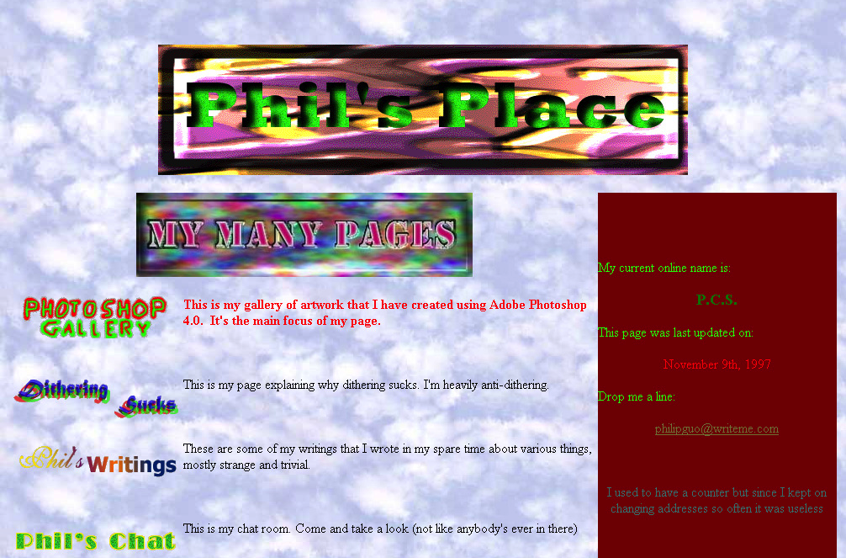
16: Color
Notes:
One of Philip Guo’s first web pages from November 1997

Slide 2
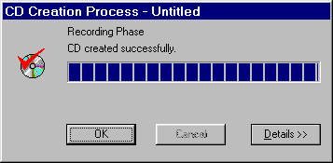

UI Hall of Fame or Shame?
Notes:
Our Hall of Shame candidate for the day is this dialog box from Adaptec Easy CD Creator, which appears at the end of burning a CD. The top image shows the dialog when the CD was burned successfully; the bottom image shows what it looks like when there was an error.
What does the squint test tell you about these dialogs? How could they use the color visual variable better?
The key problem is the lack of contrast between these two states. Success or failure of CD burning is important enough to the user that it should be obvious at a glance. But these two dialogs look identical at a glance. How can we tell? Use the squint test, which we talked about in the graphic design lecture. When you’re squinting, you see some labels, a big filled progress bar, a roundish icon with a blob of red, and three buttons. All the details, particularly the text of the messages and the exact shapes of the red blob, are fuzzed out. This simulates what a user would see at a quick glance, and it shows that the graphic design doesn’t convey the contrast.
One improvement would change the check mark to another color, say green or black. Using red for OK seems inconsistent with the real world, anyway. But designs that differ only in red and green wouldn’t pass the squint test for color-blind users.
Another improvement might remove the completed progress bar from the error dialog, perhaps replacing it with a big white text box containing a more detailed description of the problem. That would clearly pass the squint test, and make errors much more noticeable.

Slide 3
Nanoquiz
closed book, closed notes
3 minutes (timer in upper right)
if you can’t use the online form, use paper
close your laptop when you’re done

Slide 4
0:04
0:09
0:08
0:07
0:05
0:03
0:02
0:01
0:00
0:14
3:00
2:30
2:00
1:45
1:30
1:15
1:00
0:45
0:30
0:20
0:19
0:18
0:17
0:16
0:15
0:13
0:12
0:11
0:10
0:06
Consider the following (foreground, background) color pairs for text displayed on a screen, each with a reason for NOT using it in a design. Which of the reasons are valid? (choose all that apply) A. (red, blue) is risky because of color blindness B. (green, red) is risky because of color blindness C. (blue, black) is risky because of older users D. (blue, red) is risky because of chromatic aberration E. (green, yellow) is risky because of color constancy F. (black, dark gray) is risky because of contrast
Which of the following are correct about color models? (choose all good answers) A. LCD monitors use the RGB model directly. B. CMYK is used for screen colors. C. In HSV, saturation refers to brightness. D. In HLS, pure colors have lightness of 0.5.

Slide 5
Learning Objectives
Identify reasons why color matters in user interface design.
Discuss design guidelines in using color.
Evaluate and improve the color scheme of a website.

Slide 6
Why Does Color Matter?

Slide 7
Why Does Color Matter?
Identity
Affect
Emphasis on key UI elements / actions
Metaphor
Aesthetics
Gender / Culture differences
Color blindness

Slide 8
Identity
Notes:
As part of his comeback strategy for Apple, Jobs unveiled the unique, transparent, curvy and colorful "Bondi Blue" design of the first iMac G3. Advertisements for the all-in-one computer portrayed it as "Chic. Not geek.”
"The whole thing is translucent, you can see into it — it's so cool," Jobs said onstage, as all sides of the iMac were being shown to the audience via a wireless camera. "The back of this thing looks better than the front of the other guys'," he went on to say. Apple also pushed the fresh look of the new iMac in a series of commercials featuring the voice of actor Jeff Goldblum. In one television spot, Goldblum noted that the iMac was "more colorful" than the competition currently on the market. Of course, the key to Apple's strategy with the first iMac "G3" was not just its color. The desktop was also somewhat controversial at the time for omitting a 3.5-inch floppy disk drive — a legacy feature that virtually all computers at the time included. But colors became even more important to the G3 iMac in January of 1999, when the "Bondi Blue" shade was replaced with blueberry, strawberry, tangerine, grape and lime. In all, the iMac G3 was eventually released in a total of 13 different "flavors," which also included graphite, ruby, sage, snow, indigo, and the psychadelic "Flower Power" and "Blue Dalmatian" configurations.
Apple's iMac G3 was released in a total of 13 different "flavors," making it one of the most colorful products in the company's history.

Slide 9
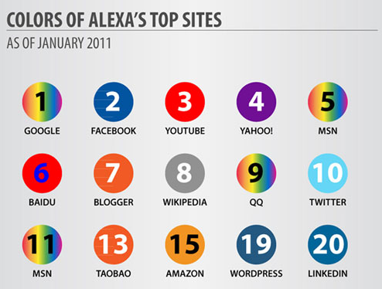
Identity
http://printmediacentr.com/2011/02/infographic-the-psychology-of-color-for-web-design/

Slide 10


Metaphor & Consistency
Stop
Wait
Go

Slide 11
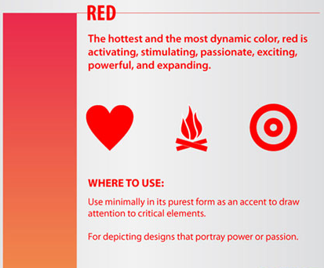
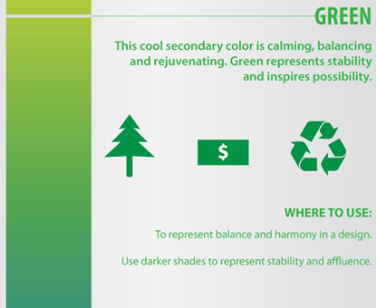
Affect
http://printmediacentr.com/2011/02/infographic-the-psychology-of-color-for-web-design/

Slide 12
Culture
http://www.informationisbeautiful.net/visualizations/colours-in-cultures/

Slide 13
Gender

Slide 14
Gender
http://blog.xkcd.com/2010/05/03/color-survey-results/

Slide 15
Gender

Slide 16
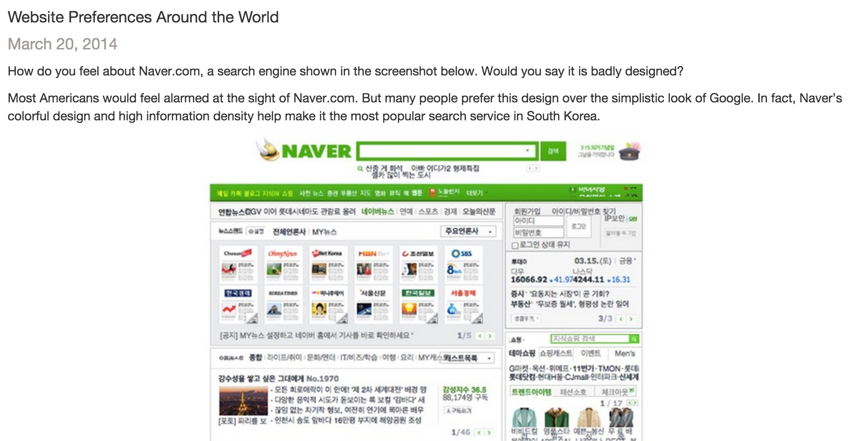
Color Perception by Demographics
Let’s check out the blog post: shoutkey.com/heyday
Notes:
Go over the blog post associated with this paper:
http://labinthewild.org/blog.php
Quantifying Visual Preferences Around the World
Reinecke and Gajos, CHI 2014

Slide 17
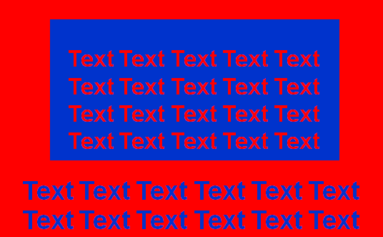
Human Vision Bugs
What is color blindness?
What is chromatic aberration?
What is color constancy?

Slide 18
Designing with color
What should you avoid doing?
How should you pick colors?
https://kuler.adobe.com
Notes:
Avoid oversaturated colors
Avoid too many colors
Avoid picking colors with no contrast
External consistency / expectations
Colors from photos
One color and shades of gray

Slide 19
Activity: RGB and HSV Color Models
What is RGB? What is HSV?
Find out what hue (H), saturation (S), and value (V) have to do with RGB:
http://shoutkey.com/pacific

Slide 20
Activity: Google’s Material Design
Read shoutkey.com/default
Why have guidelines?
What is the “primary color” for?
What is the “accent color” for?
Why have different shades of color for text?
Why have themes / schemes?
Notes:
http://www.google.com/design/spec/style/color.html

Slide 21

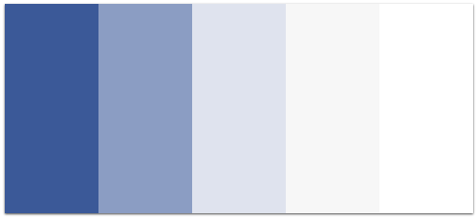
Some Practical Tips
Accent color
Primary color + shades of gray
Monochromatic
Adjacent, Triad, Complementary

Slide 22
Activity: Evaluate Color Schemes
Pair up with your neighbor.
Find a poorly colored webpage.
Analyze it with your partner.
Submit your responses at:
shoutkey.com/deny
Notes:
https://courses.csail.mit.edu/6.831/form/form.py?formkey=17h0rY-WLfZ5t4-K45crhh_f7YsO4QbqIb8RibZ6WIVk

Slide 23
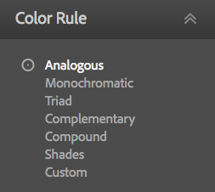
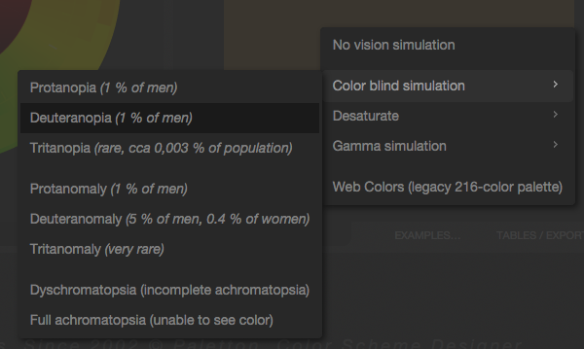
Useful Tools
https://color.adobe.com/
http://paletton.com/

Slide 24
Activity: Improve Color Schemes
In a pair, go to https://paletton.com/
Create an improved palette for the website you picked for the previous activity. Pick colors out of a photograph with natural colors.
Using Chrome Inspector or Firebug, apply your new palette to the website.
Grab a screenshot of before and after, and email them to juho@juhokim.com

Slide 25
0:04
0:09
0:08
0:07
0:05
0:03
0:02
0:01
0:00
0:14
3:00
2:30
2:00
1:45
1:30
1:15
1:00
0:45
0:30
0:20
0:19
0:18
0:17
0:16
0:15
0:13
0:12
0:11
0:10
0:06
Consider the following (foreground, background) color pairs for text displayed on a screen, each with a reason for NOT using it in a design. Which of the reasons are valid? (choose all that apply) A. (red, blue) is risky because of color blindness B. (green, red) is risky because of color blindness C. (blue, black) is risky because of older users D. (blue, red) is risky because of chromatic aberration E. (green, yellow) is risky because of color constancy F. (black, dark gray) is risky because of contrast
Which of the following are correct about color models? (choose all good answers) A. LCD monitors use the RGB model directly. B. CMYK is used for screen colors. C. In HSV, saturation refers to brightness. D. In HLS, pure colors have lightness of 0.5.

